Slide 1
Integration Testing
Ensuring Seamless Interactions Between Components

Slide 2
Table of Contents
1. What is Integration Testing?
2. Why is Integration Testing Important?
3. Integration Test Approaches
4. Applications of Integration Testing
5. Test Cases for Integration Testing
6. Difference Between Manual Testing and Automated Testing
7. Conclusion

Slide 3
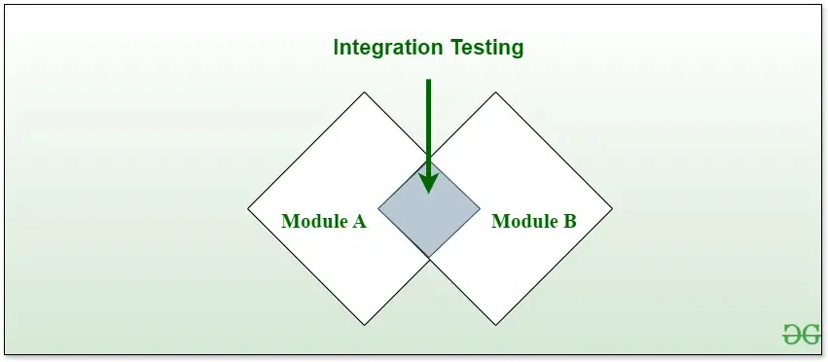
What is Integration Testing?
Is a test ensure that different modules or components of a system work together.
Focuses on data flow and communication between modules.

Slide 4
Why is Integration Testing Important?
Detects issues in module interactions early.
Ensures proper communication between software components.
Prevents system failures caused by improper integration.
Improves reliability, scalability, and overall quality of the system.

Slide 5
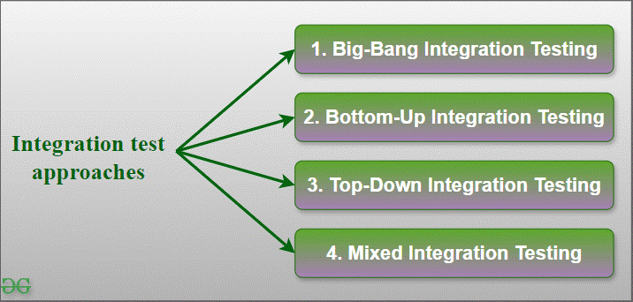
Integration Test Approaches
1. Big Bang Testing: All components are tested together in one go.
2. Top-Down Testing: High-level modules are tested first.
3. Bottom-Up Testing: Low-level modules are tested first.
4. Mix Testing: Combines Top-Down and Bottom-Up approaches.

Slide 6
Applications of Integration Testing
Web Applications: Ensures proper interaction between front-end and back-end.
APIs: Validates communication and data exchange.
E-commerce Platforms: Tests payment gateways and user interfaces.
Enterprise Software: Ensures smooth connections between modules.

Slide 7
Test Cases for Integration Testing
Verify data flow between modules.
Test API calls and responses.
Validate shared databases or file transfers.
Check error handling during module interactions.

Slide 8
Difference Between Manual Testing and Automated Testing
Manual Testing: Performed by humans without tools, time-consuming and prone to errors.
Automated Testing: Uses tools/scripts for automation, faster and more reliable.

Slide 9
Conclusion
Integration testing ensures that all components work together seamlessly.
Helps identify and fix issues early.
Combining manual and automated testing maximizes efficiency.

